Slide 1
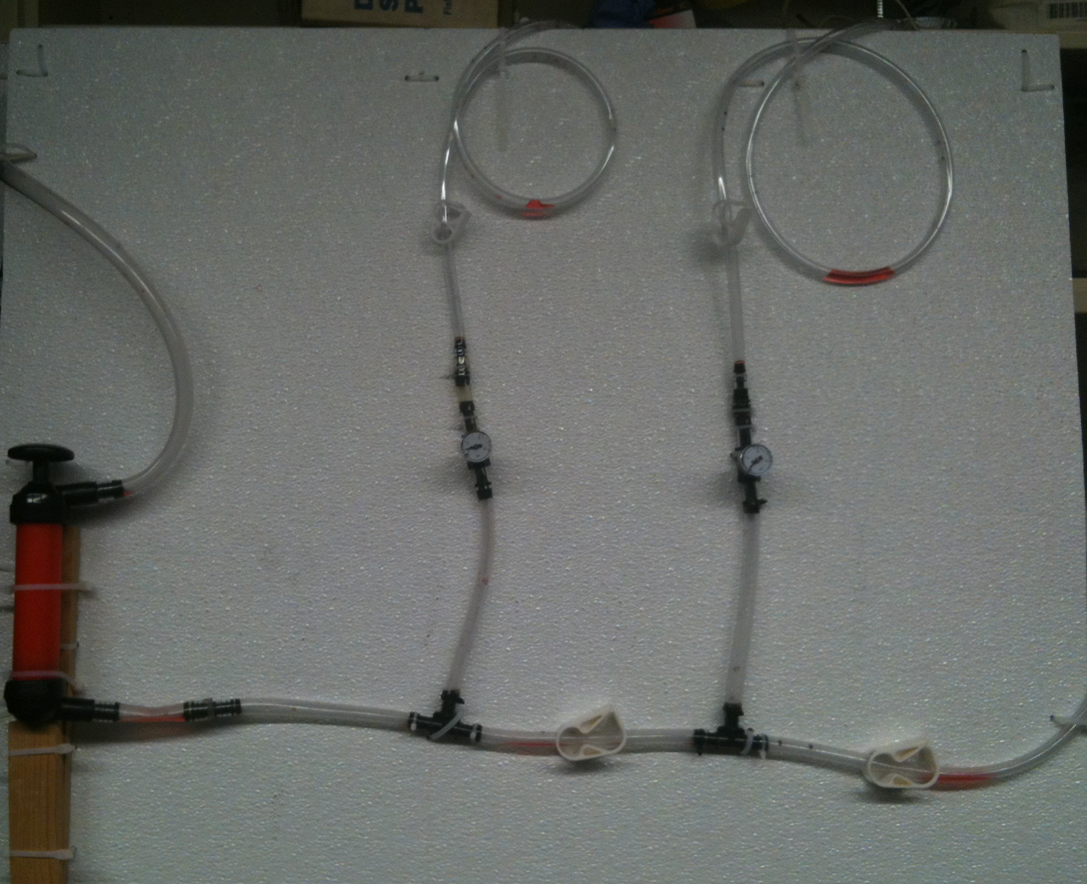
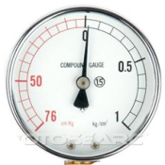
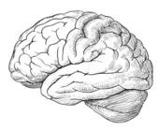
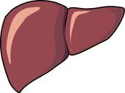
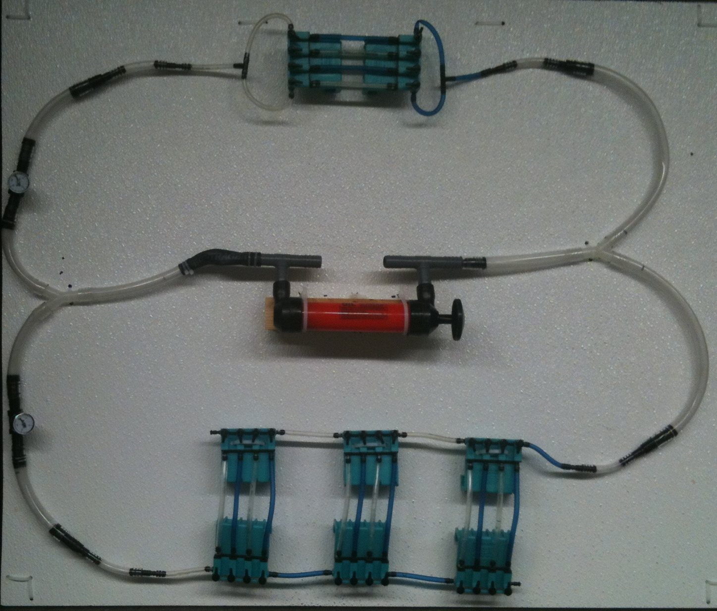
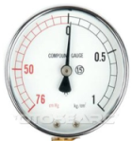
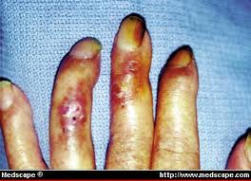
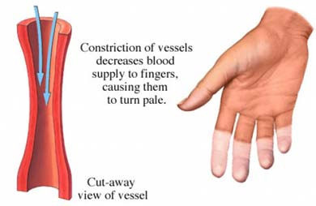
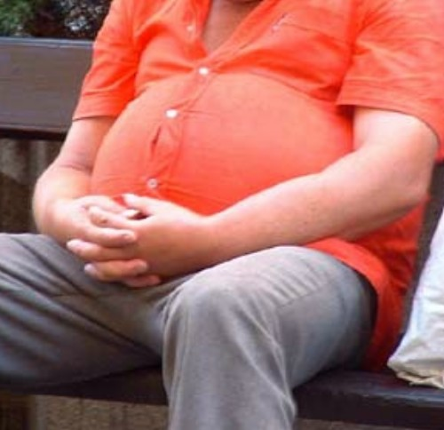
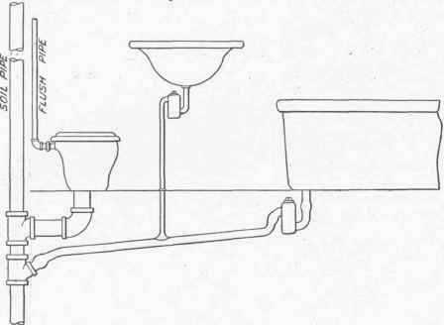
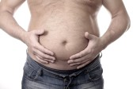
STEM & Health: Stressors on the circulatory system
C. Stanley¹, R.M. Krall², D. Johnson³, Zeidler-Watters³, R.L. Cooper¹
¹Dept. of Biol., Univ. of KY; ² Dept. of STEM, Univ. of KY; ³PIMSER Eastern Kentucky University, Richmond, Kentucky
http://web.as.uky.edu/Biology/faculty/cooper/ABLE-2019/Cardiovascular%20issues-blood%20flow-%20viscosity-plaque/home-cardiovascular%20issues.htm
Abstract:
The goal of these problem-based modules is to explore the effects of health-related issues (e.g., obesity, arteriosclerosis) on pressures in the circulatory system. Modeling and engineering design are key practices comprising the Next Generation Science Standards making these modules timely and very suited for life science classrooms at the middle, secondary, and introductory college levels. These STEM modules bridge biology, physics and health concepts for an integrative approach to learning fluid dynamics and physiology in authentic situations. Physiological issues represented include: (1) plaque formation and effect on flow, (2) elastic recoil and arteriosclerosis, (3) effects of blood viscosity, and (4) differential blood pressure related to resistance. Exercises guide learners in assembling human circulatory system models used to explore the physics of pressures related to tubing, flow, and resistance. Findings from the investigations are used to construct diagnoses and recommended treatments for patients in problem scenarios. The modules also emphasize the importance of a healthy lifestyle.
DESIGN, INQUIRY, DEMONSTRATION & CONTENT
Future goals
1. Guided inquiry
2. Student discussion on their system
Higher level
Constriction
or a clog
Lower level
3. Build a dynamic
model
We are collaborating with Dr. Christine Schnittka (Dept. of STEM, Univ. of KY) in development of kits for teachers and students to use in order to teach the general concepts related to this educational model.
“The National Academy of Sciences has just released the final version of "A Framework for K-12 Science Education." This framework will be used to write new national standards for science education called Next Generation Science Standards. Many states will be adopting these standards, and faced with new challenges. One significant challenge is that the new science standards will subsume "engineering" as a disciplinary core idea along with life sciences, earth/space sciences, and physical sciences.”
(http://www.uky.edu/~csc222/engineering.htm from
Dr. Christine Schnittka's web page)
Give students a box of tubes and items to construct a model for blood flow with fat deposits or water flow for a street drain with litter build up.
Time to design (engineering) their system.
Provide students with a chance to discuss their ideas (builds interaction within group) and confidence in presenting. Listen to other groups and their ideas. As a class draw similarities in the physics for city drainage and blood circulation.
Time to re-design (engineering) their system from class feedback.
Pump
Tubes
Bernoulli's principal
4. Higher level: More complete design of
human circulatory system
5. Elastic aorta maintains pressure wave
Blood is carried away from the heart through the aorta and then through arteries that get progressively smaller. Arteries carry oxygenated blood to different organs of the body such as the brain, liver, kidneys, and muscles.
CONCLUSION
6. Build a dynamic model to test ideas
Depending on the audience the pre/post-test content will be understood in a health-related manner.
The assessments could be more general on fluid properties and the physics depending on the class.
Advanced high school teachers could use for teaching across disciplines.
The design aspect develops engineering abilities.
This could be turned into reverse engineering concepts as well. Provide a model and ask the students to design a better model
College level classes could readily make use of model to collect data and graph data related to concepts in physics and formulas.
5. Misconceptions can be examined and tested with the model in the student’s own design.
INTRODUCTION
Basic chemistry and life science education is an integral part of K-12 life science curricula (National Research Council [NRC], 1996). The study of one’s body can be explained with visual demonstrations and a short educational presentation is of major importance for achieving a greater understanding of natural phenomena. These concepts also are a major focus of life science concepts outlined in the National Science Education Standards (NSES) (National Research Council [NRC], 1996). For animal physiology (Bio350) and introductory biology classes (Bio152) the general concepts in chemical buffering and physiological relevance is an integral part of the concepts to be taught. If the content can be enhanced with demonstration and a specific presentation on the subject, the students should gain a good understanding on the learning objectives. The teaching at the senior citizen activity center is health-related education to inform the audience the importance of understanding the effect of obesity, smoking and atherosclerosis on blood pressure. Nurses (RN’s) serve as nurse educators for LPNs and CNAs and it is important that they obtain teaching modules that can be effective to teach other health care providers as well as the clients they take care of first hand. To understand the relationship of factors that alter peripheral arterial resistance and their effects on the body, having the ability to use visual, hands-on models to teach physiological concepts can be beneficial. The ability to retain and understand a concept is known to be enhanced with hands-on activities. There is an expression which is common for active engaged learning which applies here: “hands-on minds-on” (Hitt et al., 2005; Pheeney, 1997).
For high school and middle school students, the ability of the students to assemble a model from a provided kit, to represent the human circulatory system and relate the physics of how pressures are altered due to health related issues (obesity, atherosclerosis), should promote the importance of why a healthy life style is advantageous. The hope is that we will be able to provide cardiovascular kits to classrooms in the future for teachers to teach their students that will bridge biology, physics and health concepts for an integrative approach to learning within STEM.
Exercise
7. Extension of model
METHOD
Test the idea on model:
-Delivery of more oxygen.
-Dilate blood vessels to muscle.
References
Cold : Raynaud's disease
Abimbola, I. (1988). The problem of terminology in the study of student conceptions in science. Science Education, 72(2), 175-184.
American Association for the Advancement of Science. (1993). Benchmarks for science literacy. Oxford: Oxford University Press.
Ausubel, D.P. (1968). Educational psychology: A cognitive view. New York: Holt, Reinhart, and Winston.
Driver, R. Guesne, E. & Tiberghien, A. (1985). Children’s ideas in science. Philadelphia: Open University Press.
Glaser, B.G., & Strauss, A.L. (1967). The discovery of grounded theory: Strategies for qualitative research. Mill Valley, CA: Sociology Press.
Glesne, C. (2006). Becoming qualitative researchers: An introduction, 3rd edition. Boston: Pearson Education, Inc.
Hitt, A., White, O., and Hanson, D. (2005) Popping the kernel: Modeling the states of matter. Science Scope 28 (4):39-41.
Lovell, M., Myers, K., Forbes, T.L., Dresser, G., and Weiss, E. (2011). Peripheral arterial disease: application of the chronic care model. J. Vasc. Nurs. 29(4), 147-152.
National Research Council. (1996). National science education standards. Washington DC: National Academy Press.
Nussbaum, J., & Novak, J.D. (1982). Alternative frameworks, conceptual conflict and accommodation: Toward a principled t eaching strategy. Instructional Science, 11, 183-200.
Osborne, R., & Freyberg, O. (1985). Learning in science: the implications of children’s science. Aukland, NZ: Hinemann.
Palmer, D.H. (1999). Exploring the link between students. scientific and nonscientific conceptions. Science Education, 83, 639-653.
Pines, A.L. & West, L.H.T. (1986). Conceptual understanding and science learning: An interpretation of research within a sources-of-knowledge framework. Science Education, 70(5), 583-604.
Pheeney, P. (1997) Hands-on, minds-on: Activities to engage our students. Science Scope 21(4): 30-33.
Rubin, H.J. & Rubin, I.S. (1995). Qualitative interviewing: The art of hearing data. Thousand Oaks, CA: Sage Publications.
Scott, P., Asoko, H., & Leach, J. (2007). Student conceptions and conceptual learning in science. In: S.K. Abell & N.G. Lederman (Eds.), The handbook of research on science education (pp. 31–56). Mahwah, NJ: Erlbaum.
Tabara, Y., Igase, M., Kido, T., Ochi, N., Miki, T., and Kohara, K. (2009). Composition of lower extremity in relation to a high ankle-brachial index. J. Hypertens. 27(1), 167-73.
Trundle, K. C., Atwood, R. A, & Christopher, J. E. (2002). Preservice elementary teachers’ conceptions of moon phases before and after instruction. Journal of Research in Science Teaching, 39(7), 633-658.
Vasava, P., Jalali, P., Dabagh, M., Kolari, P.J. (2012). Finite element modelling of pulsatile blood flow in idealized model of human aortic arch: study of hypotension and hypertension. Comput Math Methods Med. 2012;2012:861837. Epub 2012 Feb 13.
Wandersee, J.H., Mintzes, J.J., & Novak, J.D. (1994) Research on Alternative Conceptions in Science. In D.L. Gabel (Ed), Handbook of Research on Science Teaching and Learning (pp. 177-210). New York: Macmillan.
Smoking: vasoconstriction
What happens to cardiac output when body fat increases?
HYPERTENSION
Test the idea on model:
-Delivery of blood to fat tissue.
-More small blood vessels.
Heat transfer
Plumbing
Skin
surface
area

